Slide 1
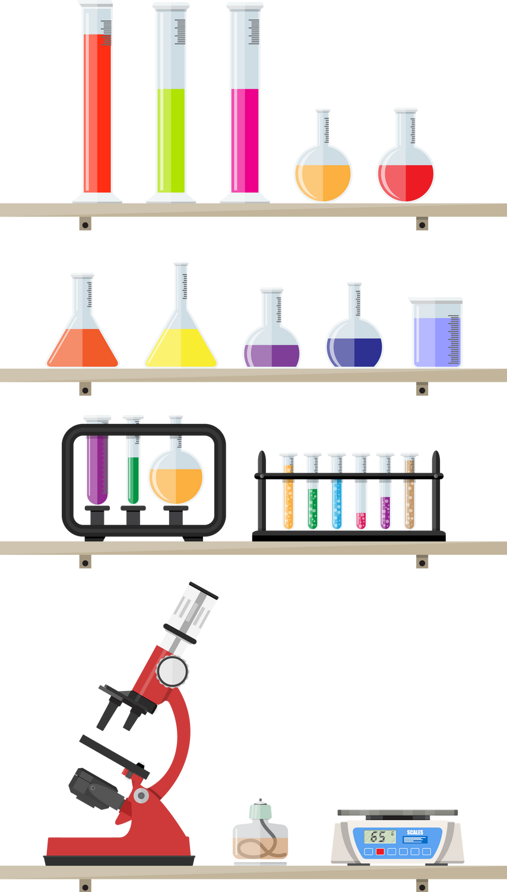


UNVEILING PII IN PRE-TRAINED MODELS: INVESTIGATING DATA ACCOUNTABILITY IN LLMS
Focuses on privacy risks in Large Language Models (LLMs).
Examines exposure to Personally Identifiable Information (PII) during pretraining.
Aims to understand and mitigate these risks.
Transforming Business and Technology

Slide 2


DESIGN AND ANALYSIS...!
MIN-K%:
Measures the smallest K% log-probabilities.
Focuses on the most uncertain tokens in a sample.
Higher negative log-probability indicates stronger recognition.
MIN-K++:
Improves MIN-K% by normalizing token probabilities.
Uses mean and standard deviation for better outlier detection.
Enhances handling of rare or less frequent tokens.
TCS (Text Confidence Score):
Combines token confidence and rarity for robustness.
Evaluates token significance based on rarity and prediction certainty.
More reliable for context-free, small-length PII like names and emails.

Slide 3

USABILITY, MANUFACTURABILITY, AND SUSTAINABILITY
Usability:
Measure system accuracy with benchmarks .
Gather feedback through stakeholder surveys and usability tests.
Compare performance against existing membership inference algorithms.
Manufacturability:
Make code publicly accessible for modifications by researchers and developers.
Explore scalability with larger models and datasets in the future.
Present real-world use cases.
Sustainability:
Ensure ongoing support and updates to the project to adapt to evolving needs.
Foster a community of contributors to maintain and enhance the system.
Develop documentation and resources to facilitate long-term usability and understanding.

Slide 4

IMPLEMENTATION
DATA:
We used the Enron dataset as "seen data" because it contains real-world emails with embedded PII, ideal for testing privacy risks.
To evaluate generalization and retention, we generated synthetic email addresses as "unseen data."
Full names were extracted from OpenWebText for experiments
Models Evaluated:
Multiple models were tested to establish a comparative analysis:
GPT-Neo variants.
GPT-2 variants.
Facebook OPT, and many others.
Methods Applied:
MINK%
MINK++.
TCS (Text Confidence Score)

Slide 5
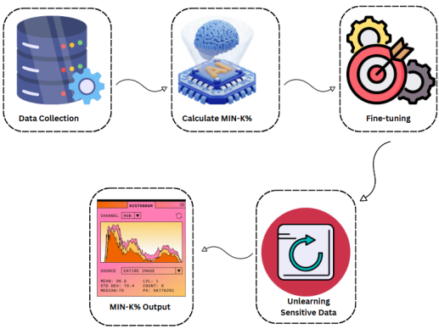
FINE-TUNING AND UNLEARNING

Slide 6
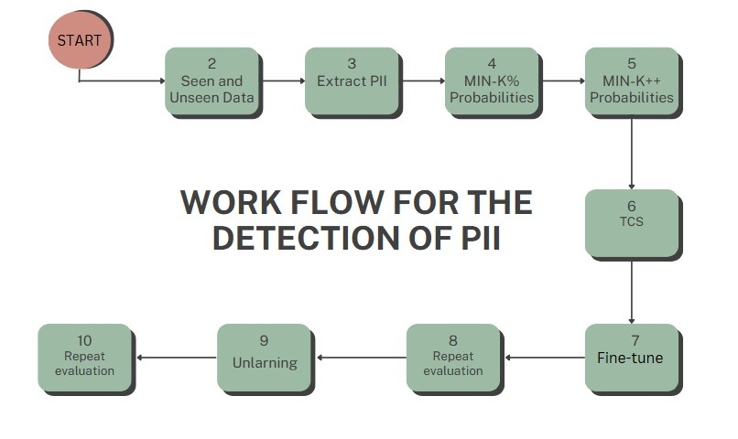
DEVELOPMENT PROCESS

Slide 7

ENVIRONMENTAL CONSIDERATIONS & SUSTAINABILITY
Energy Management:
Implement energy-efficient algorithms to minimize computational demands.
Use smaller, representative datasets to reduce overall energy consumption.
Resource Efficiency:
Utilize energy-efficient hardware and optimize code for sustainability.
Leverage renewable energy-powered cloud computing resources.
Ethical Practices:
Address data privacy concerns to promote responsible AI applications.
Foster transparency and trust in AI systems through ethical data handling.

Slide 8


Tools and Technologies...!
Python:
Primary programming language used for model implementation and data processing.
Transformers Library:
Hugging Face Transformers for working with pre-trained models like GPT-2 and GPT-Neo.
PyTorch:
DEEP LEARNING FRAMEWORK FOR TRAINING AND FINE-TUNING MODELS.
Datasets Library:
Hugging Face Datasets for easy access to various datasets like Enron and synthetic data.
Faker Library:
Used to generate synthetic PII data (e.g., names, emails).
TQDM:
Used for progress bars to track the progress of long-running tasks.
Matplotlib:
Used for visualizing results, including histograms and probability distributions.
Google Colab / Kaggle:
Cloud platforms used for running the experiments, providing GPU support.

Slide 9
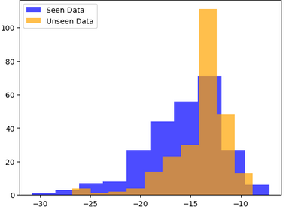
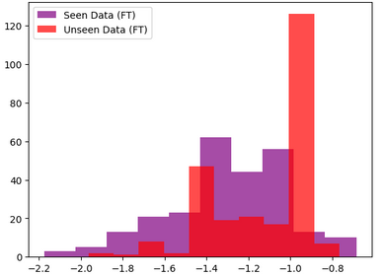
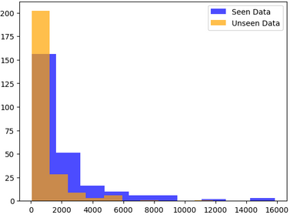
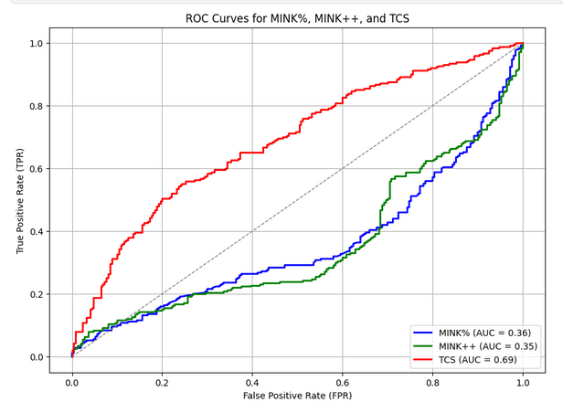
RESULTS
MINK GPTNEO
MINK++ GPTNEO
TCS GPTNEO
MINK GPTNEO

Slide 10
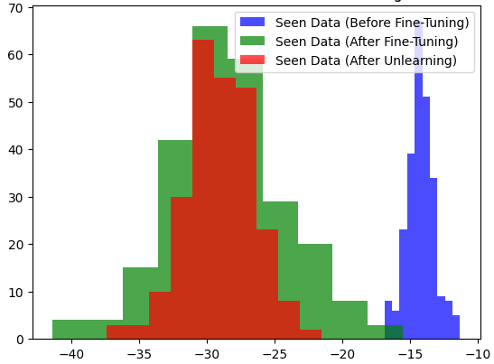
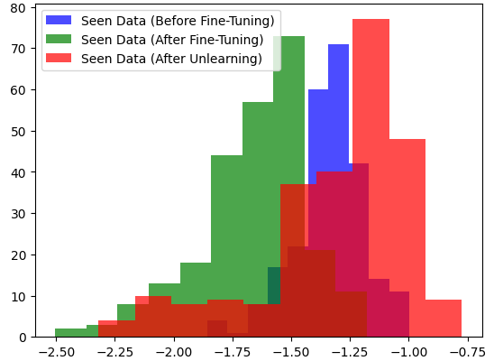
FINE-TUNING AND UNLEARNING RESULTS
MINK% for Pre FT, FT, Unlearned GPT-MED
MINK++ for Pre FT, FT, Unlearned GPT-MED

